Slide 1

FEMICIDES Bad registration by the Mexican government?
Author: Luis Alfonso Garcia Camacho Data source: INEGI, Government of Mexico

Slide 2
Context
The term femicide was not used by the Mexican government until 2011¹, when it has been recognized worldwide since 1976². On pages such as the official ones of the Mexican government, there are no records of femicides until 2015³. An extensive and detailed definition of femicide in Mexico is given on its government page⁴. The increase in femicides per year may be a sign of a poor record over the years by the Mexican government.

Slide 3
Data Quality
Homicides of Women
Femicides
Death data come from the official INEGI¹ databases. It contains a record with many details about deaths from 1990-2022. Important columns: ENT_OCURR, LISTA_MEXICO, BAS LIST, GENDER, DIA_OCURR, MES_OCURR, ANIO_OCUR. It does not contain empty rows or cells. Unknown data is populated as 99, 9999, etc.
Data obtained from the official website of the government of Mexico, where it compiles information related to crime incidence². Crime records from 2015-2023. Important columns: YEAR, ENTITY, MODALITY, JANUARY, FEBRUARY,...,DECEMBER It does not contain empty rows or cells. Unknown data is populated as NO DATA.

Slide 4







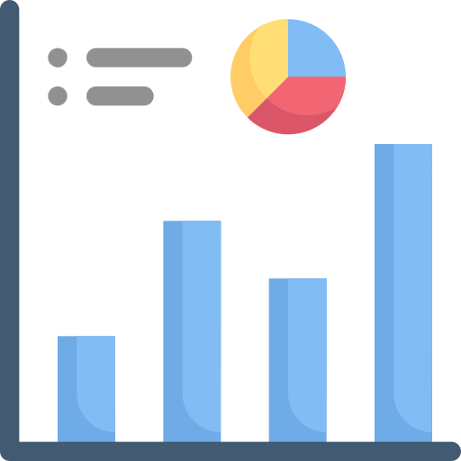



Data processing

Slide 5


Significant quantities
Homicides of Women (1990-2022)
Femicides (2015-2022)
69422
Homicides of Women (2015-2022)
7190
28158

Slide 6
Homicides of women by year(1990-2022)

Slide 7
Homicides of women by year (2015-2022)

Slide 8
Femicides by year (2015-2022)

Slide 9
Percentage of Femicides (2015-2022)

Slide 10
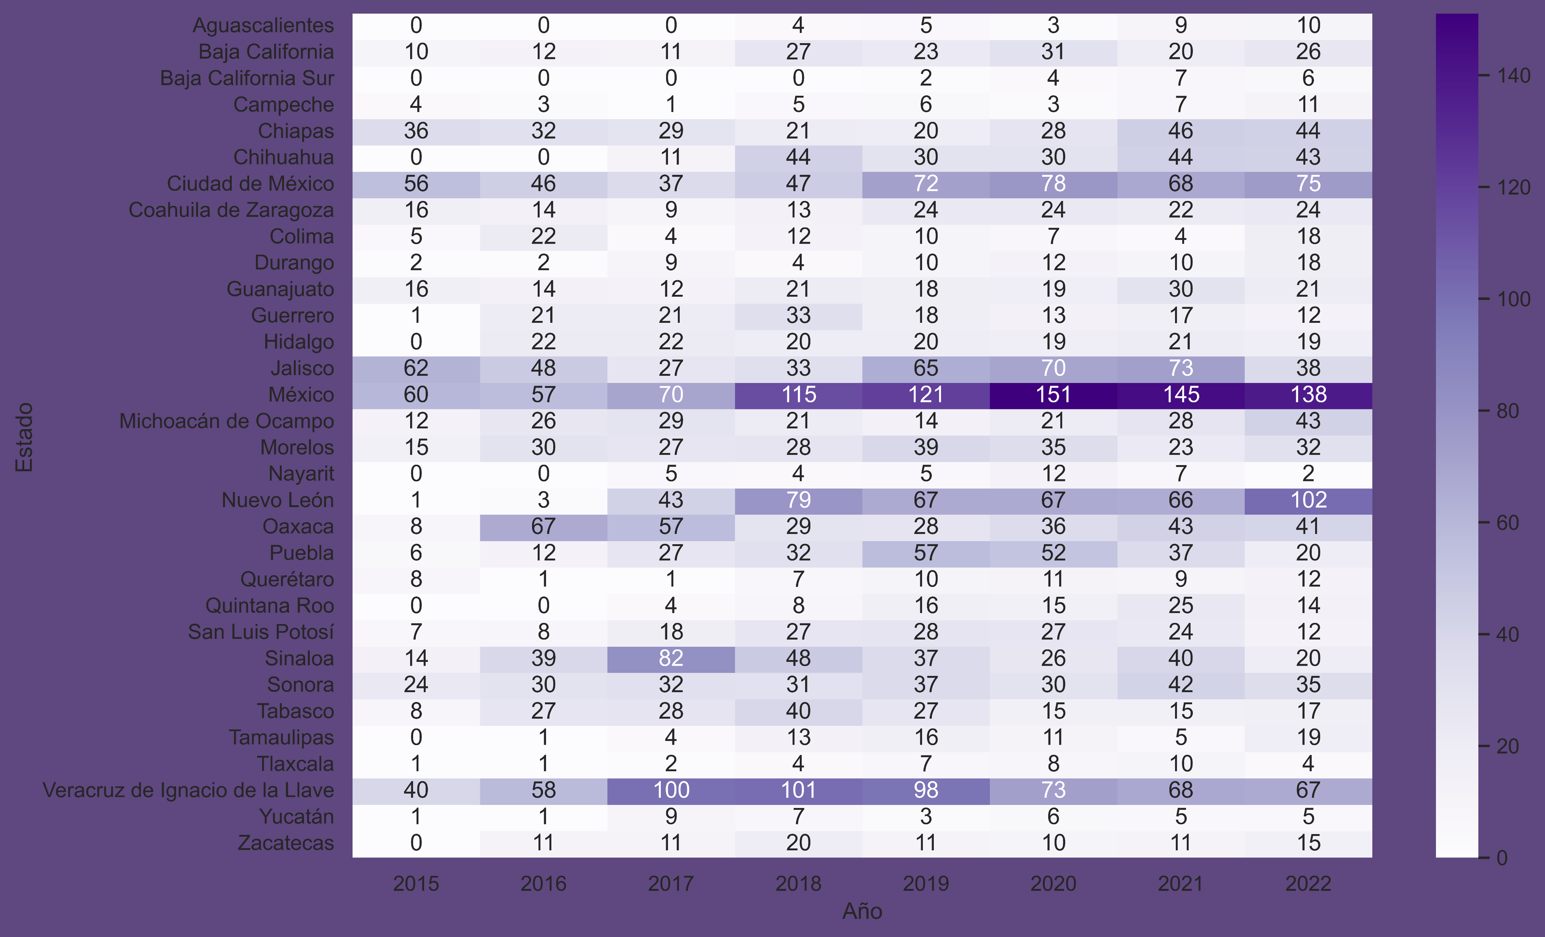
Heat Map of Femicides by State (2015-2022)

Slide 11
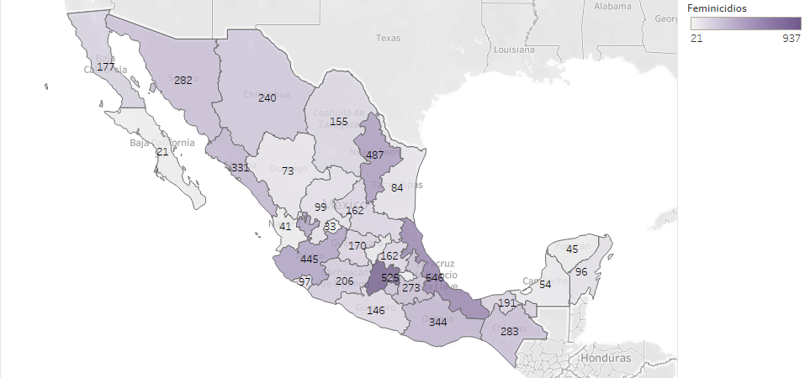
Homicides of women (1990-2022)

Slide 12
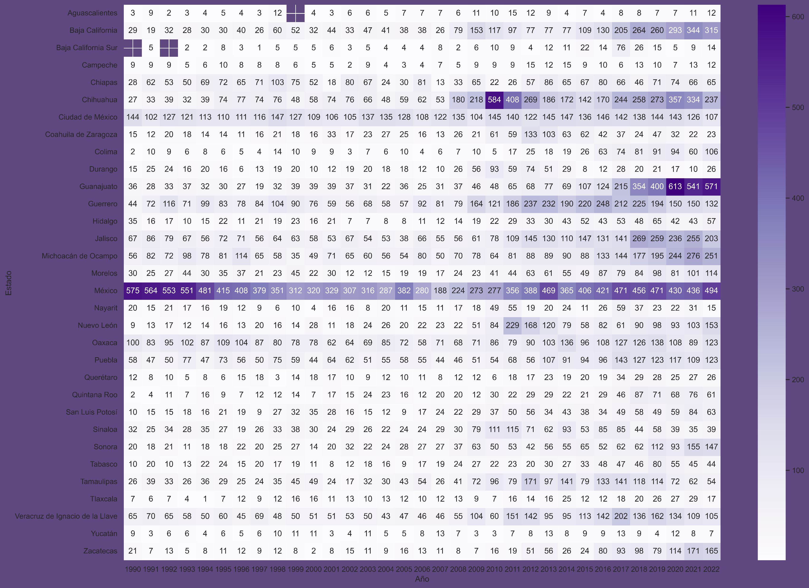
Homicide Heat Map by State (1990-2022)

Slide 13
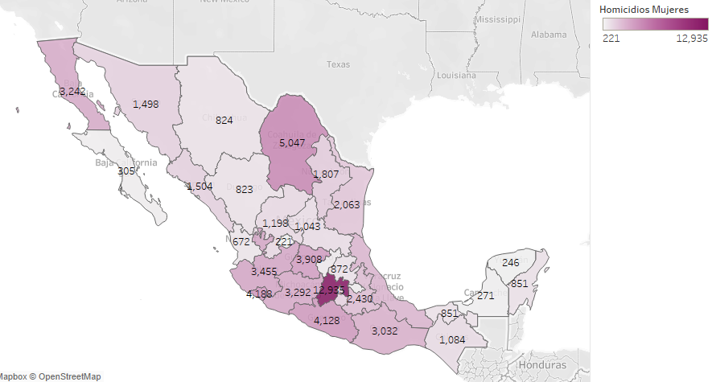
Homicides of women (1990-2022)

Slide 14
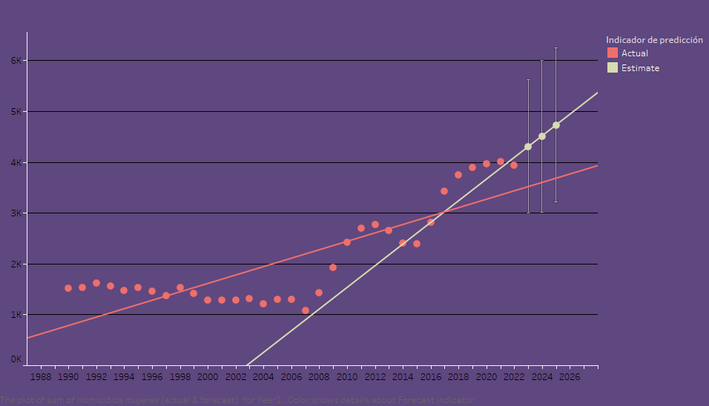
Linear Adjustment Homicides (1990-2022)

Slide 15
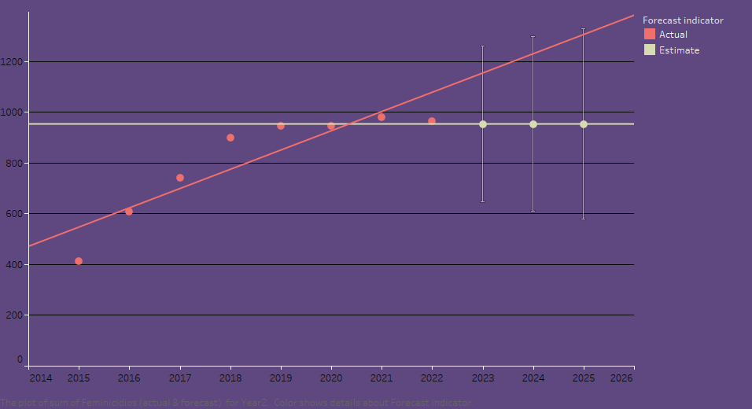
Linear Adjustment Femicides (2015-2022)

Slide 16
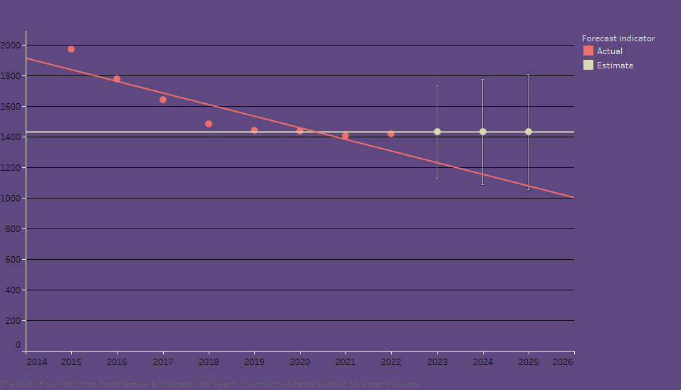
Linear Adjustment Other Types(2015-2022)

Slide 17
Time series with the number of Femicides (2015-2022)

Slide 18
Objectives
Calculate an approximate number of past femicides. Predict future numbers of Homicides of Women and Femicides.
Methodology
Organize each of the Homicides of Women and Femicides. Use a time series method and make predictions. We chose to use the prophet package made by Facebook.

Slide 19
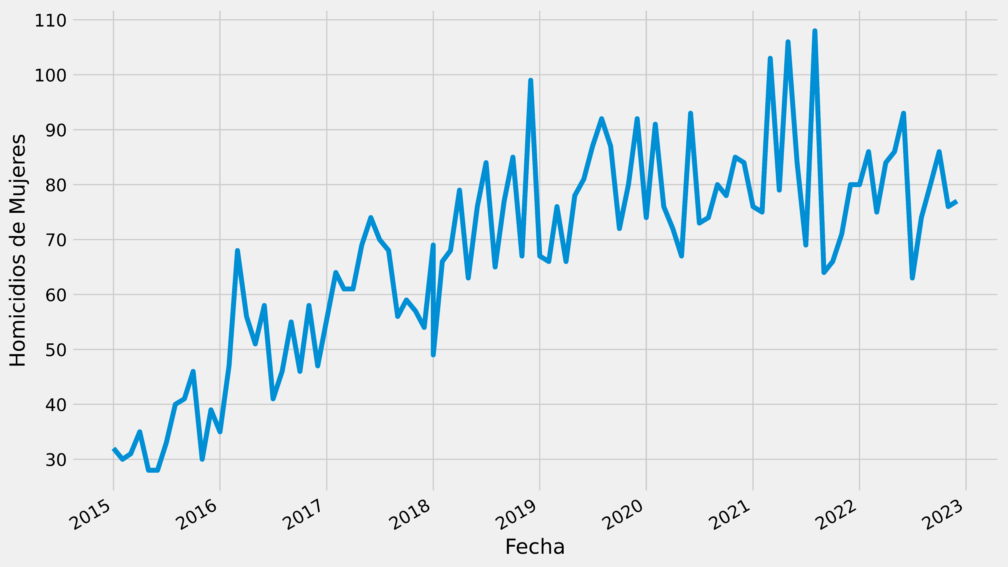
First graph of the number of Femicides by month (2015-2023)
Clear increase over the years. As far as 2023 is concerned, it only goes as far as October.

Slide 20
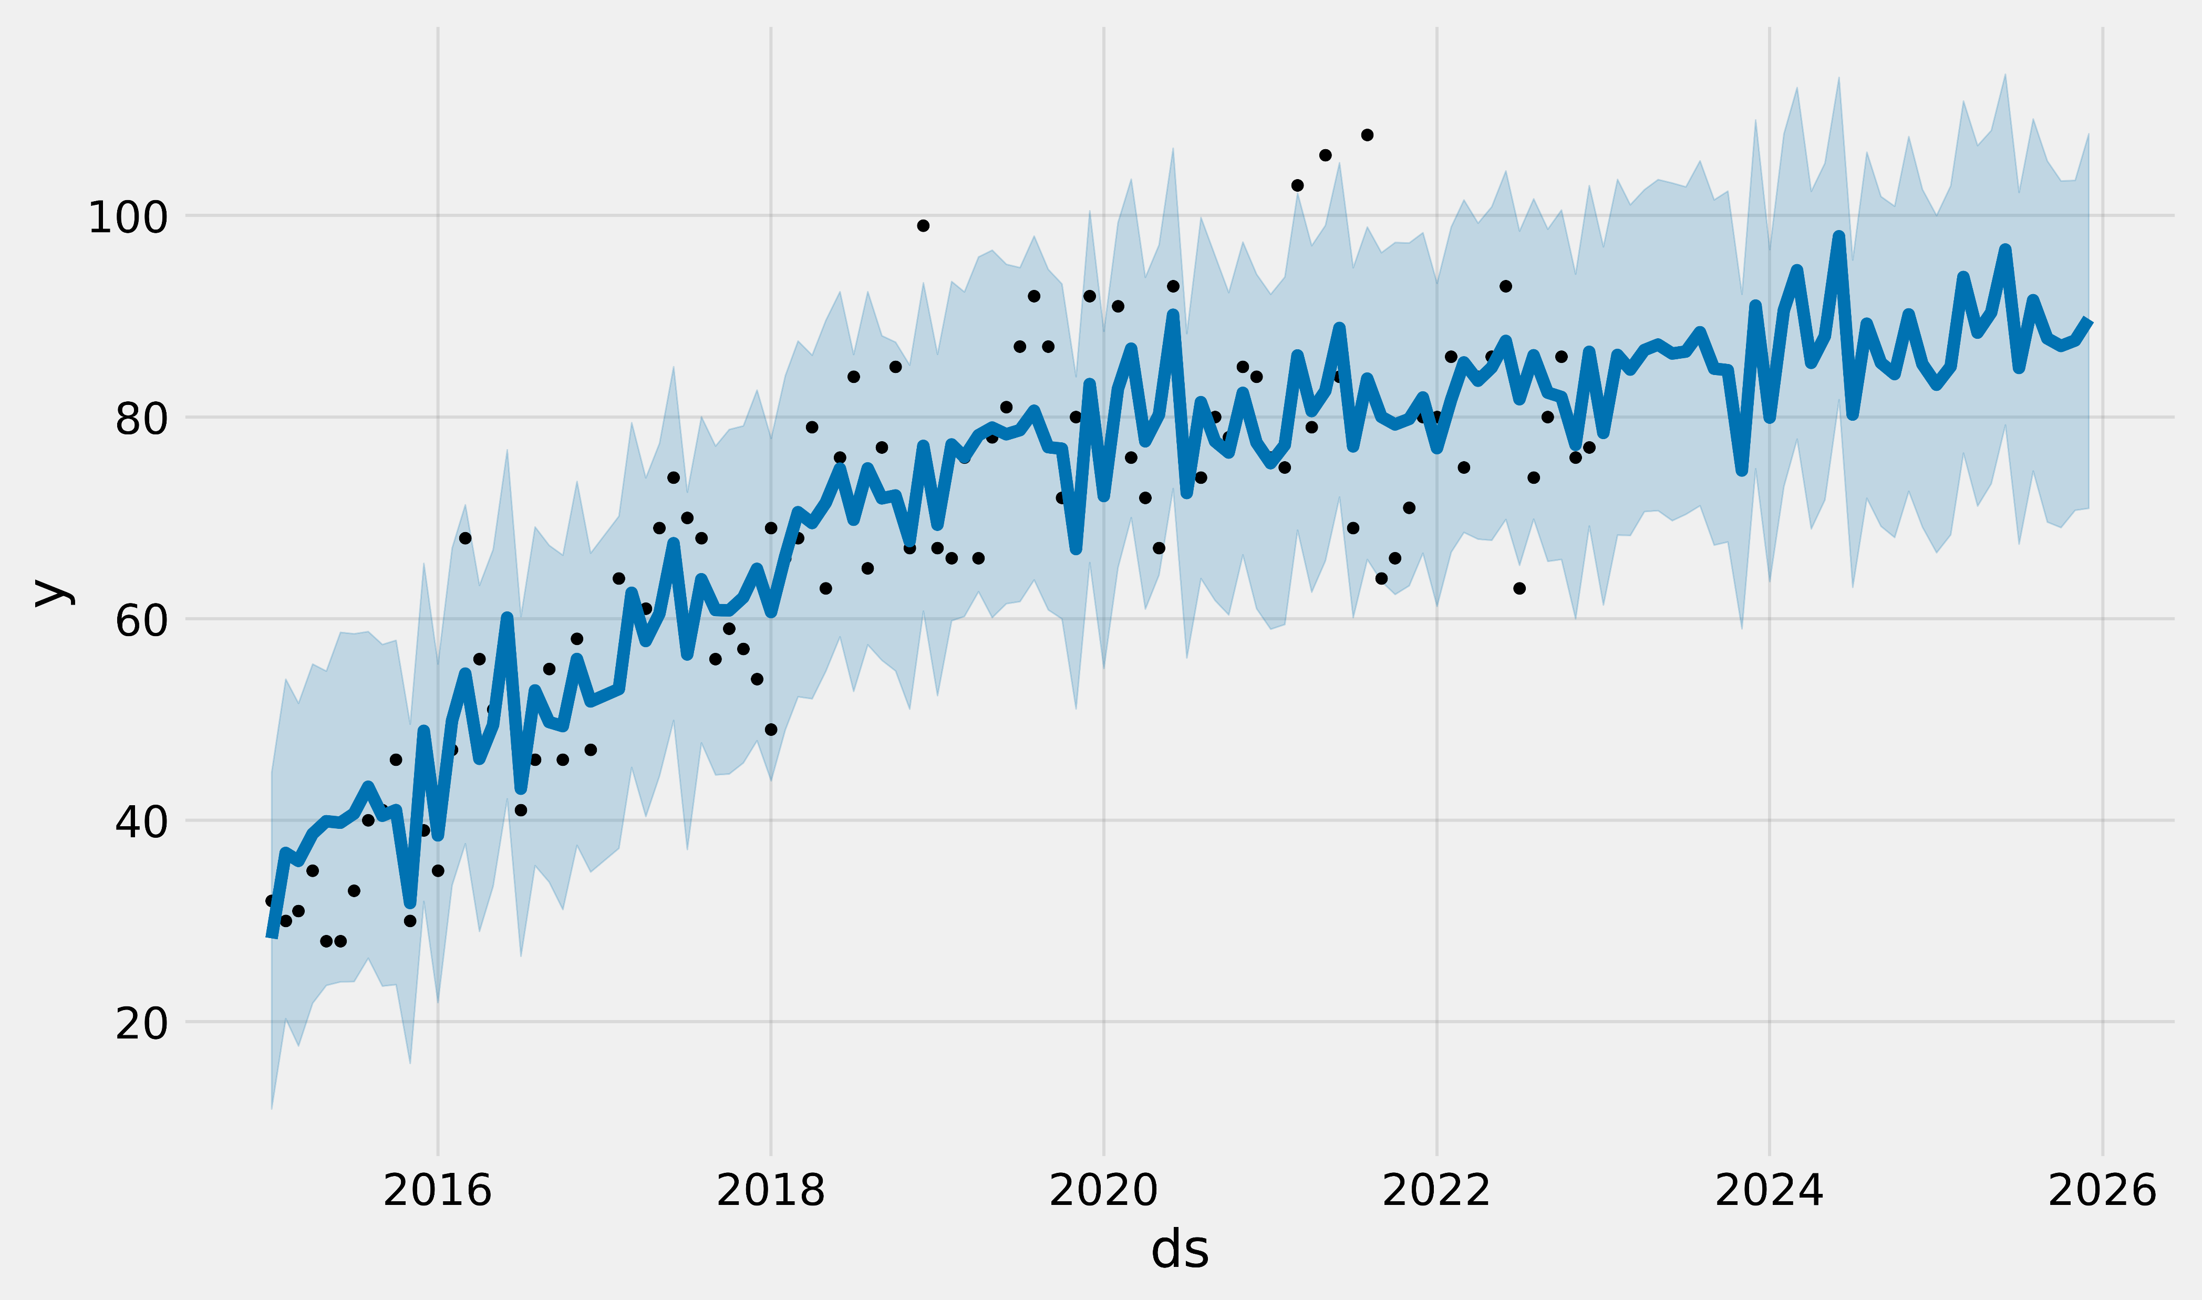
First Predictions of Femicides
Prophet shows the numbers of female homicides (the black dots), the predicted values (blue line), and the uncertainty intervals of the predictions (the regions shaded in blue) Information limited to monthly counting. Clear trend towards growth even in confidence intervals.

Slide 21
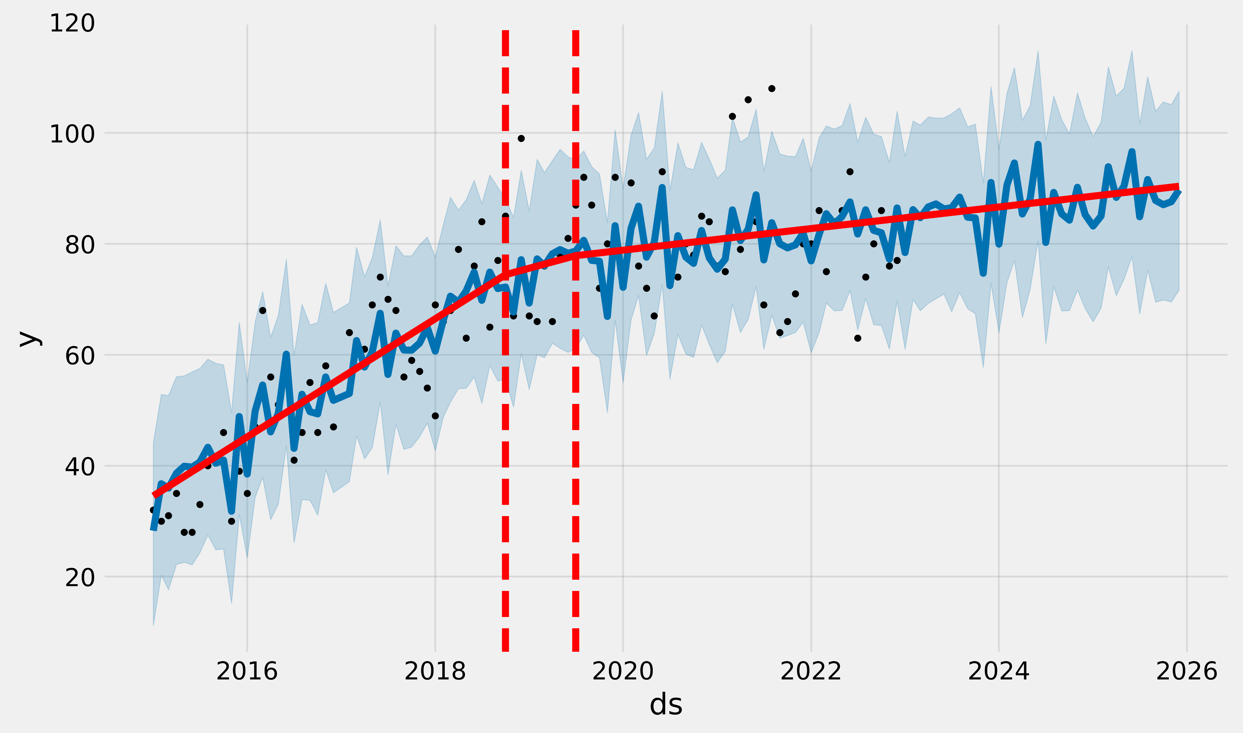
Predictions with Changing Lines
The red lines represent points where there were big changes, referring to the year 2019. The red line is a prediction that is clearly going to increase.

Slide 22
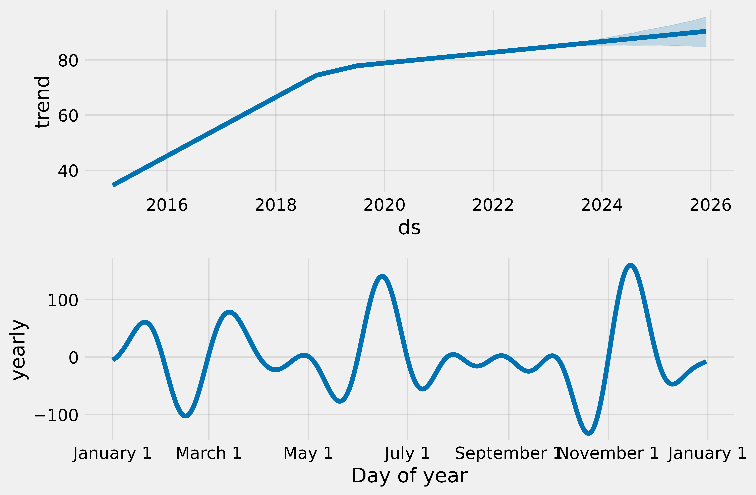
Trend Lines
Predicted average of approximately 100 femicides per month by 2024. The months with the highest number of femicides are in June and December.

Slide 23
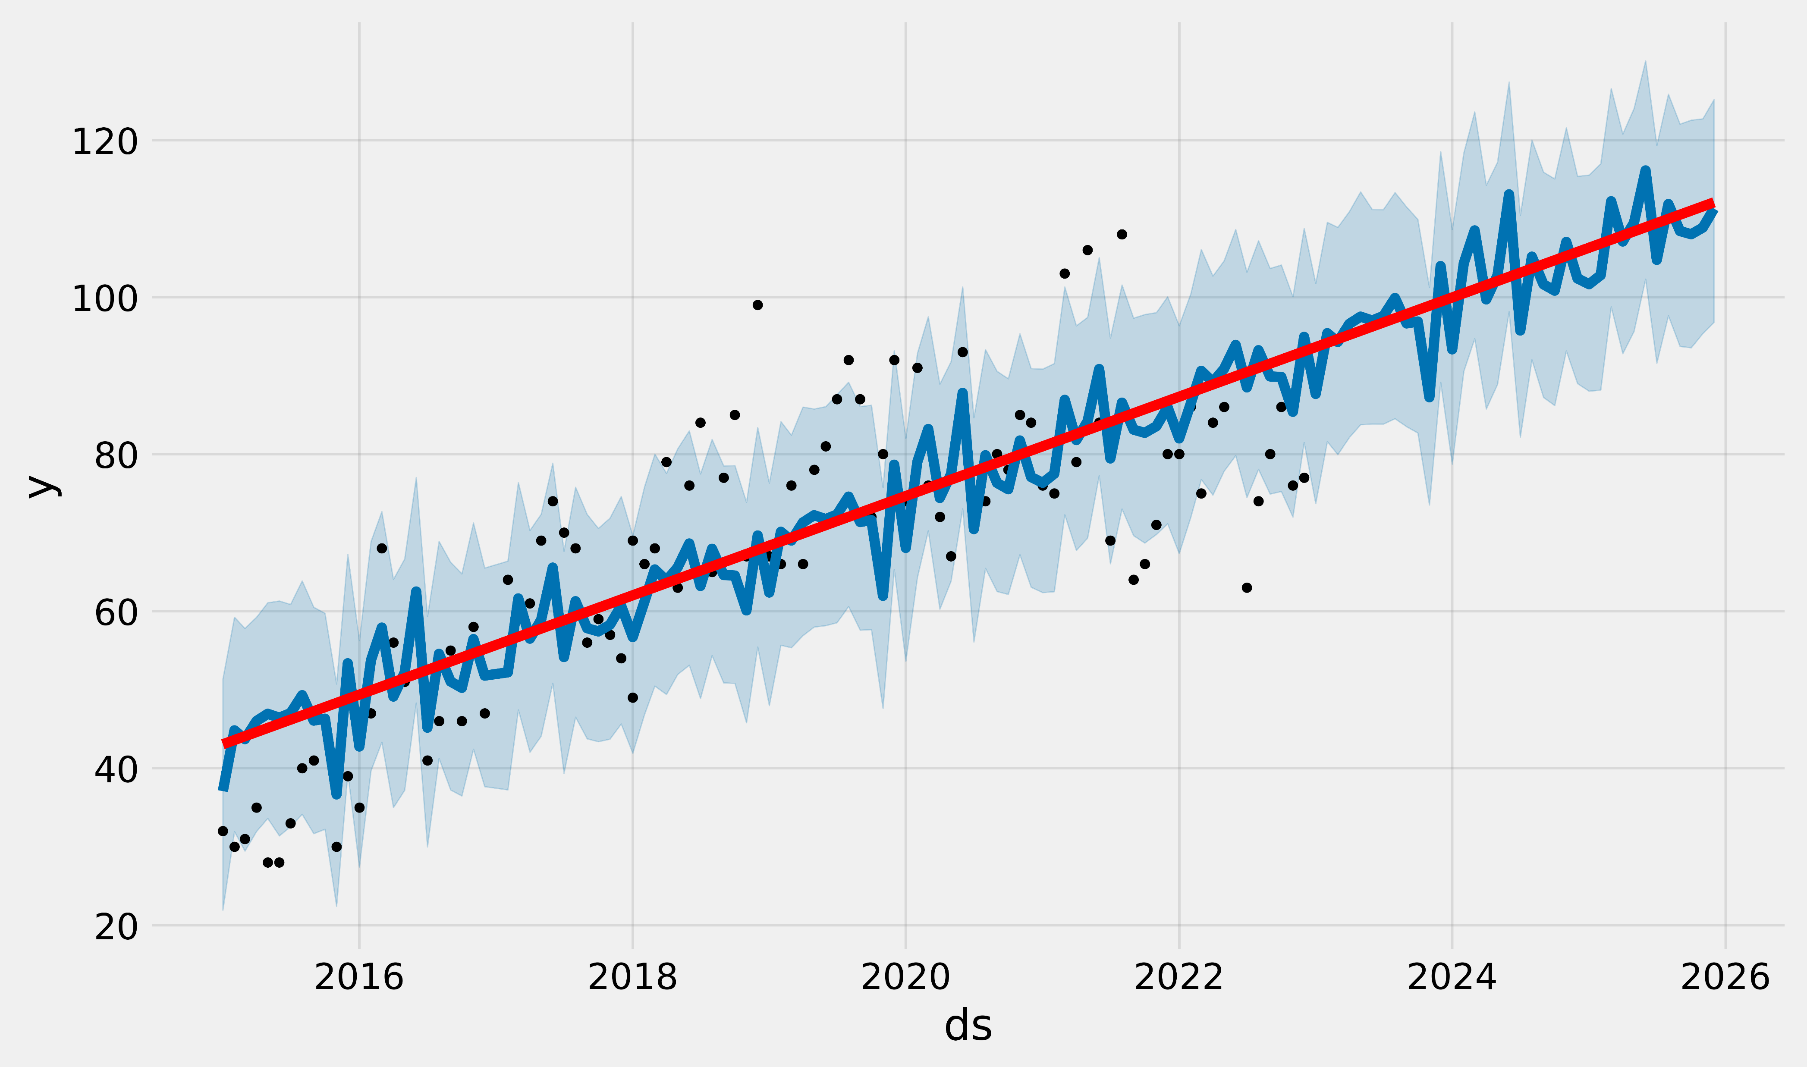
Restricting
Changed changepoint_prior_scale to 0.001 (Prophet's function) to decrease the flexibility of the prediction. Similarly, there is a clear increase in the number of femicides. It looks like what could be found by linear regression models.

Slide 24
Time series with the number of Homicides of Women (1990-2022)

Slide 25
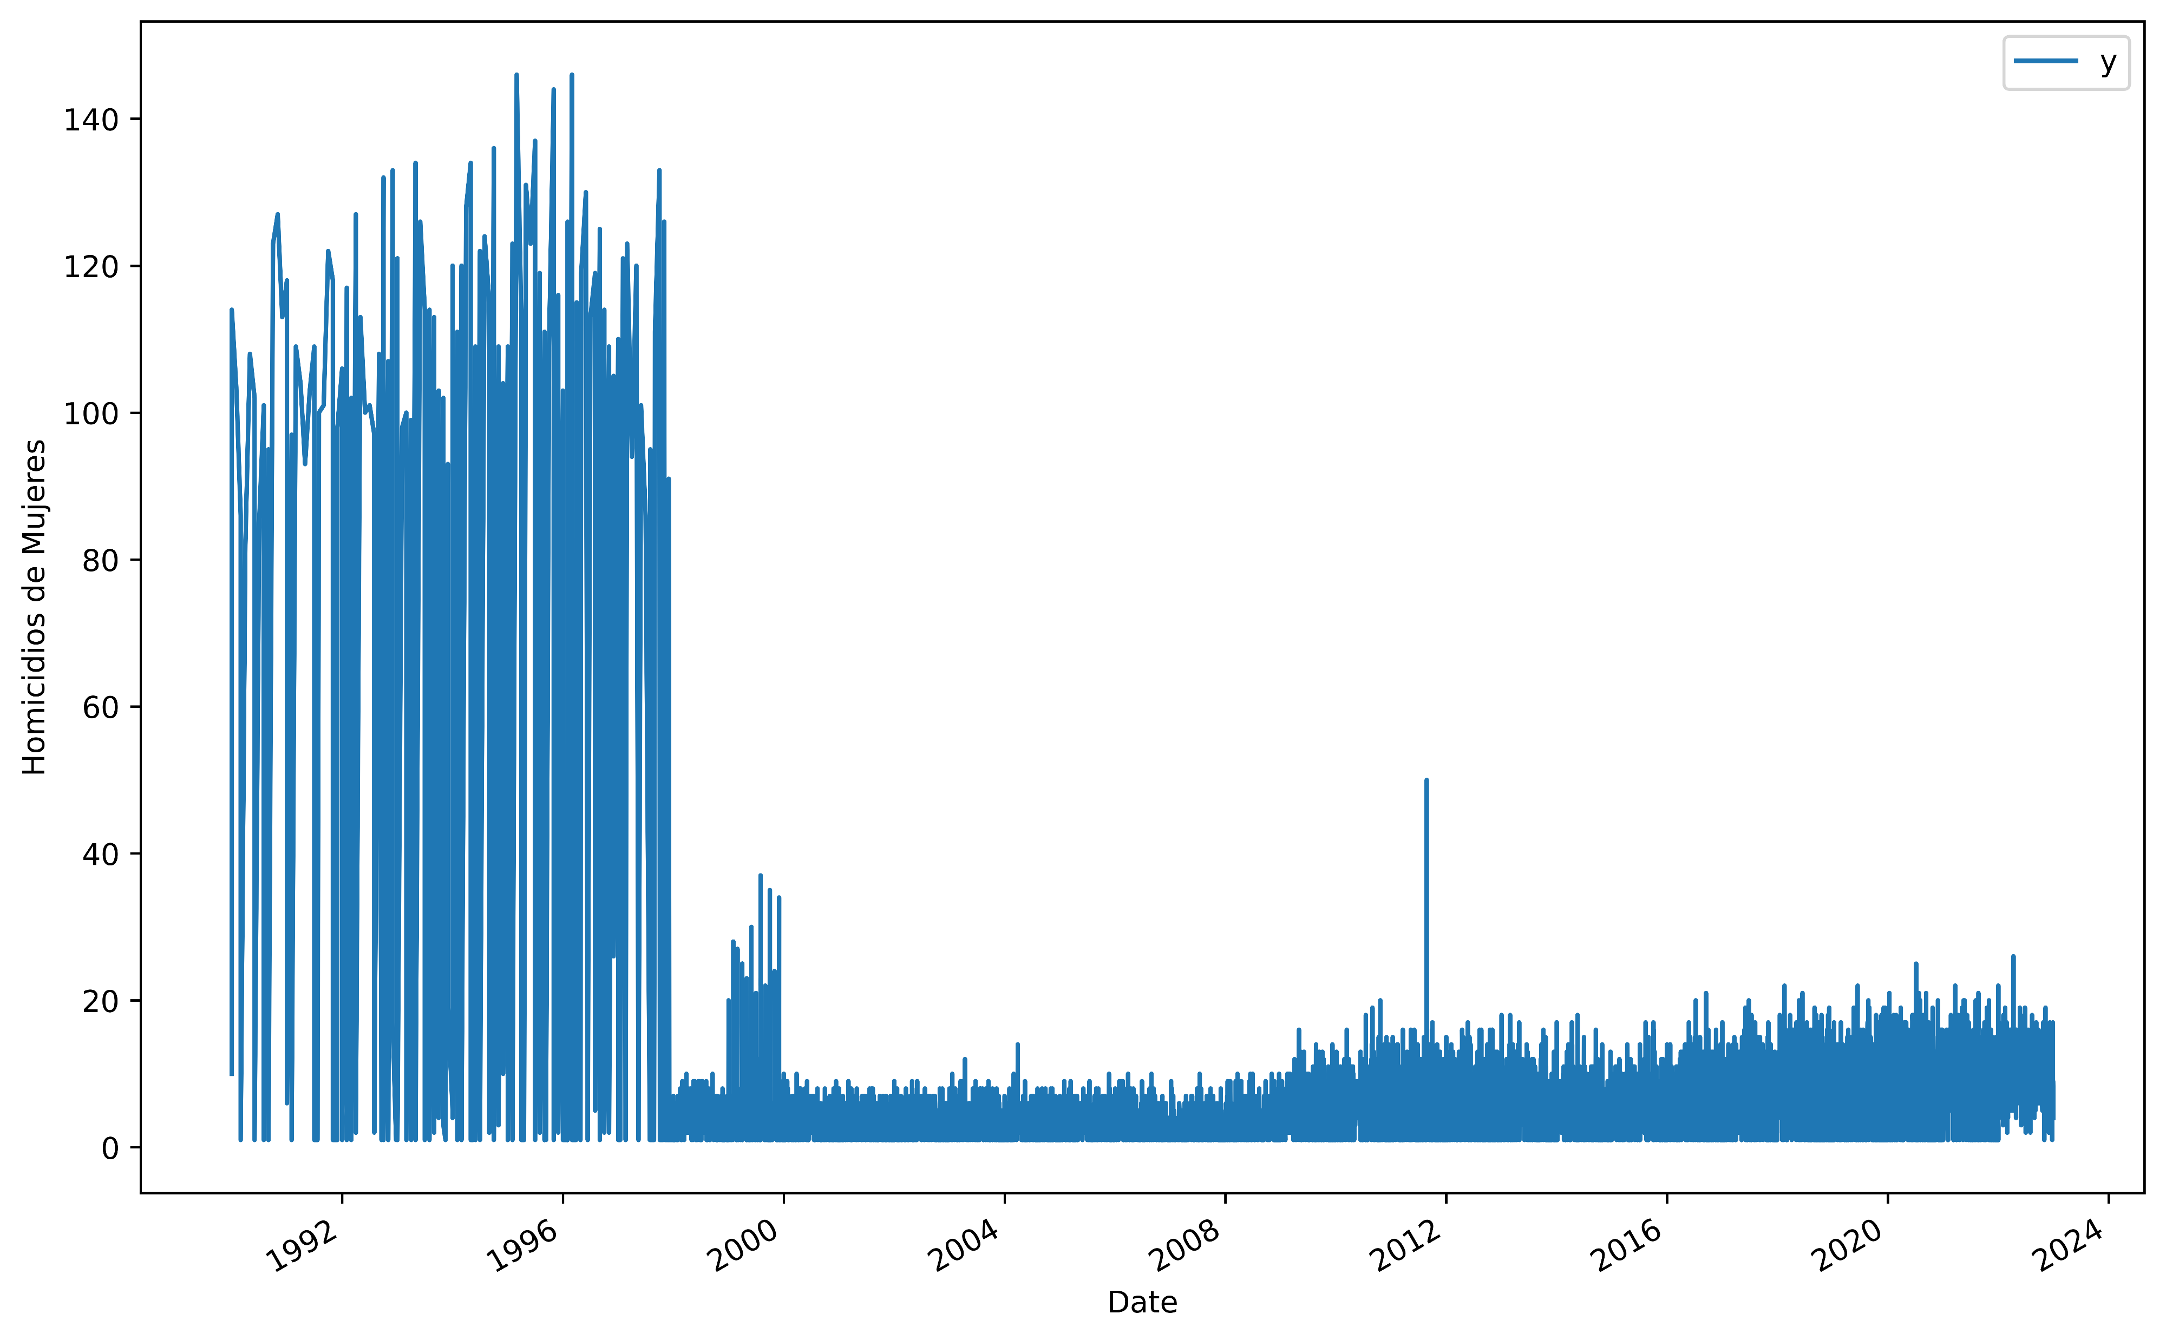
First graph of the number of Homicides of Women (1990-2023)
Problems from 1990-1997 as only the month of occurrence was recorded, but not the day.

Slide 26
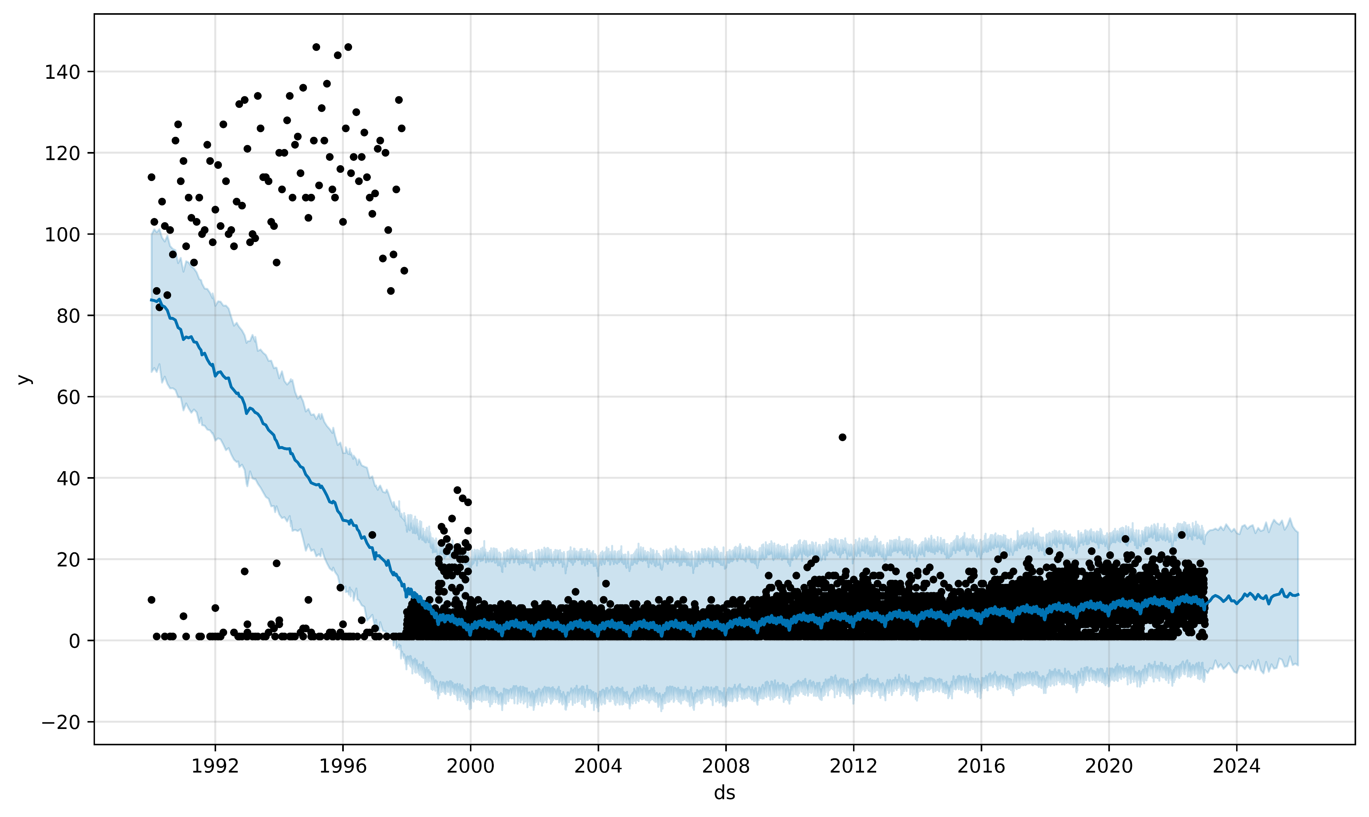
First Predictions of Homicides of Women
Same components as in Femicides. It is important to note that it does not take the points that leave the trend (1990-1997).

Slide 27
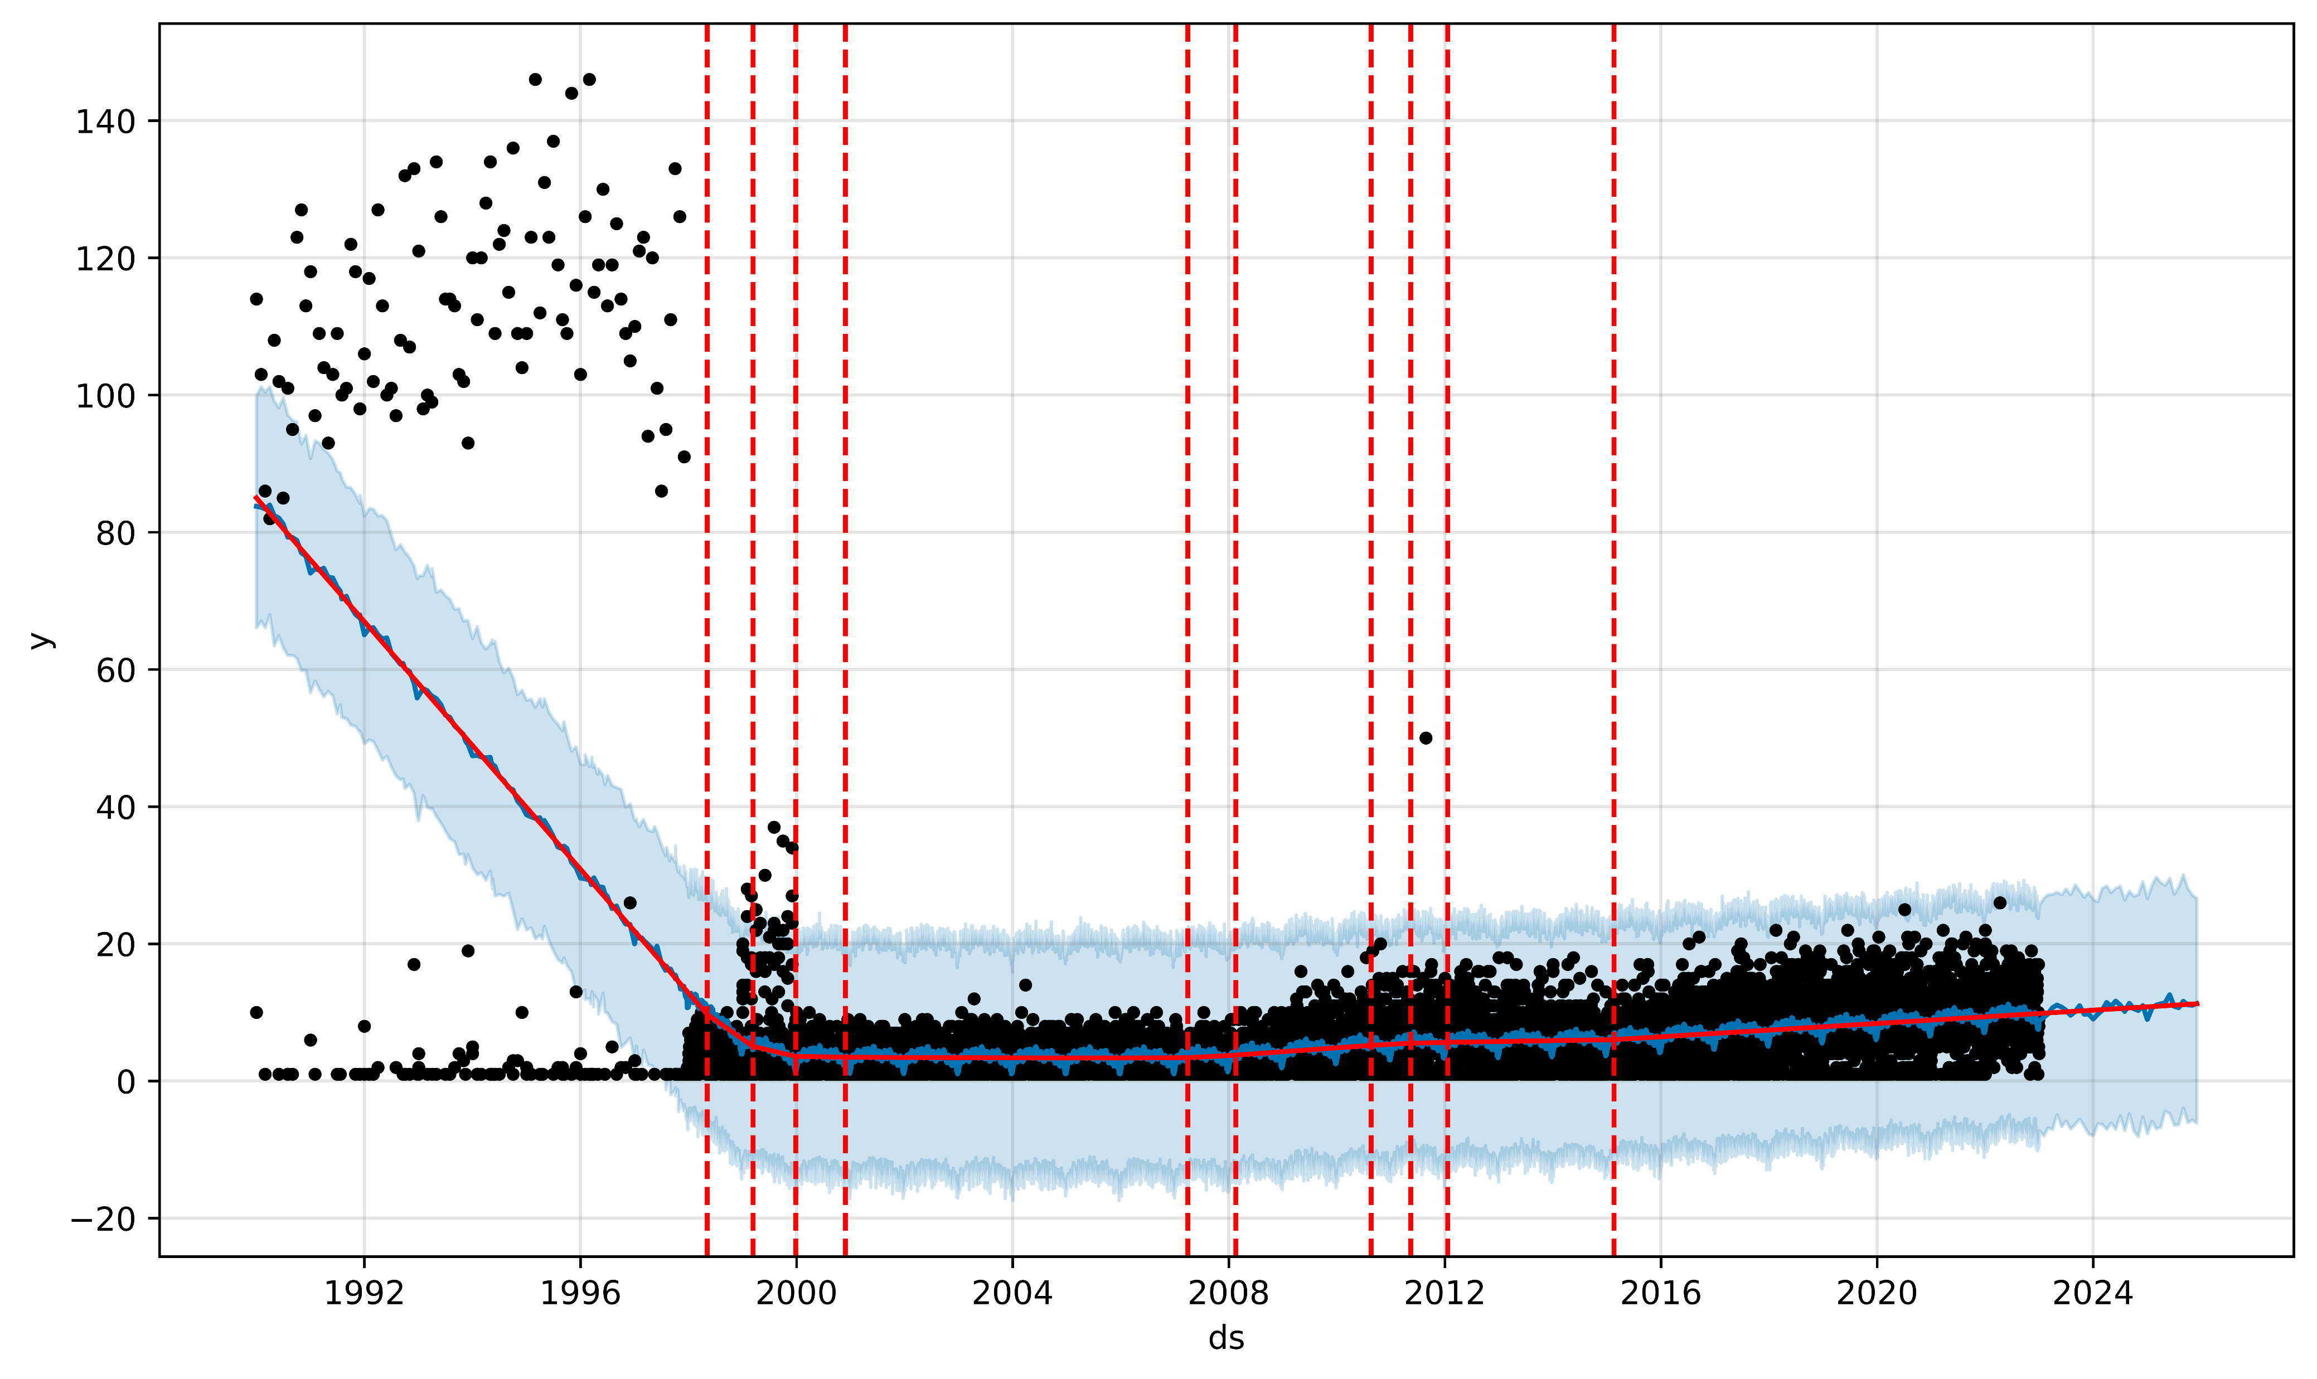
Predictions with Changing Lines
We see a very clear increase for the next few years. Big changes don't seem to follow any trend.

Slide 28
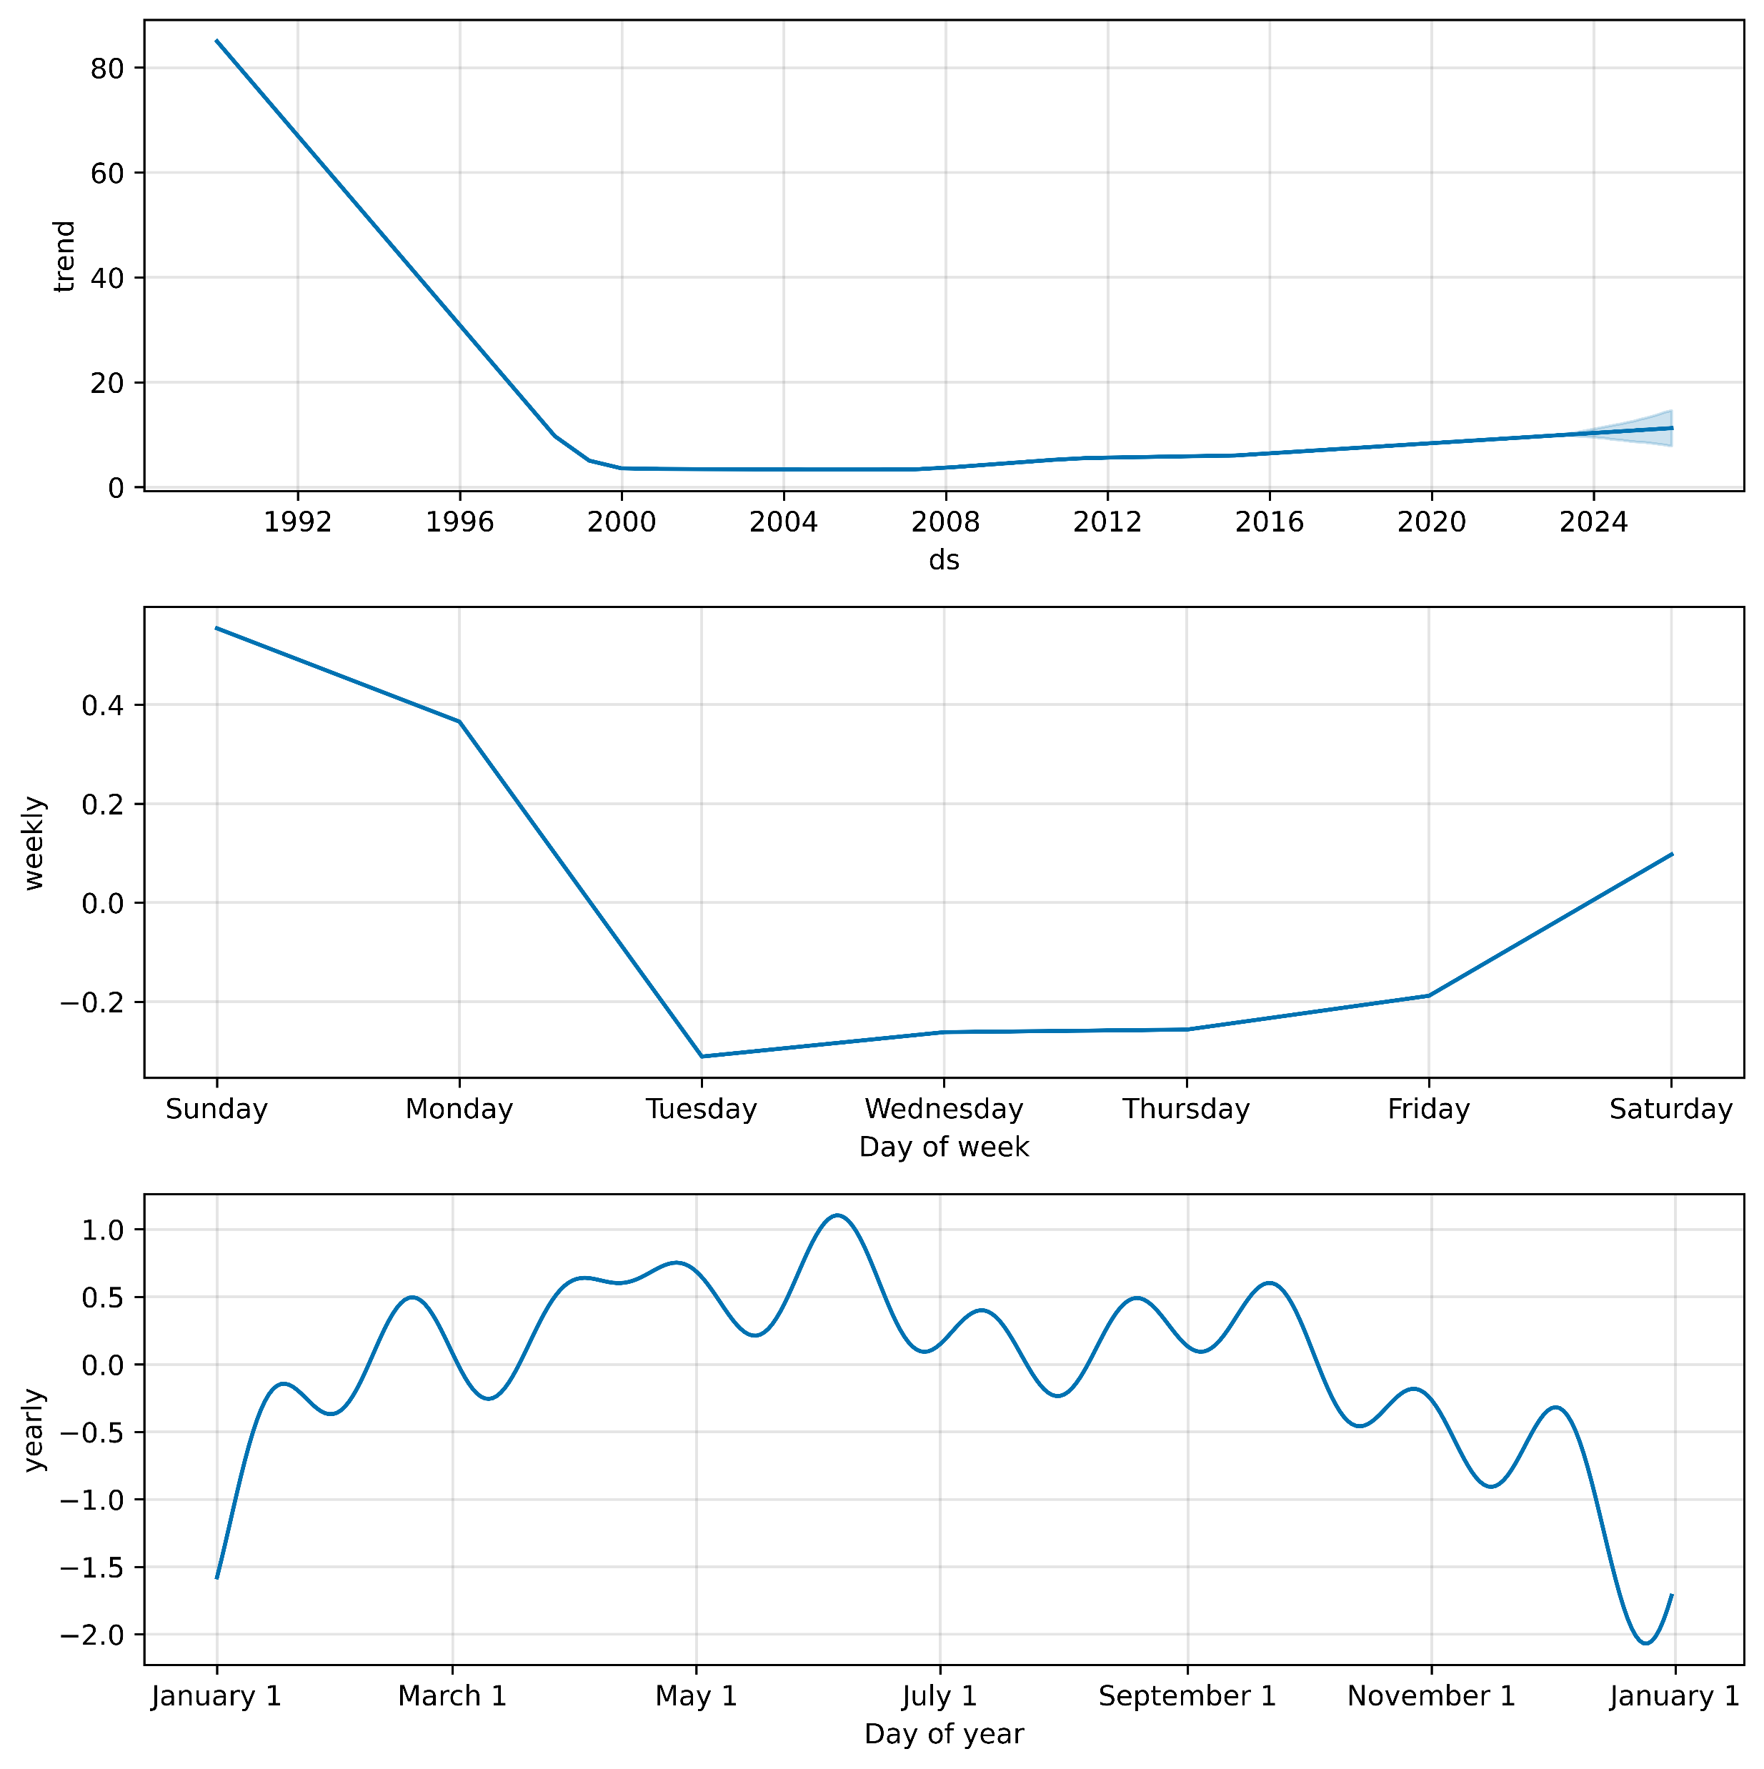
Trending
The average for 2024 is expected to rise to about 16 homicides per day. The most likely days for homicides of women are Sunday and Monday. As for the months, the most likely is in June, but there is no big trend in a given month.

Slide 29
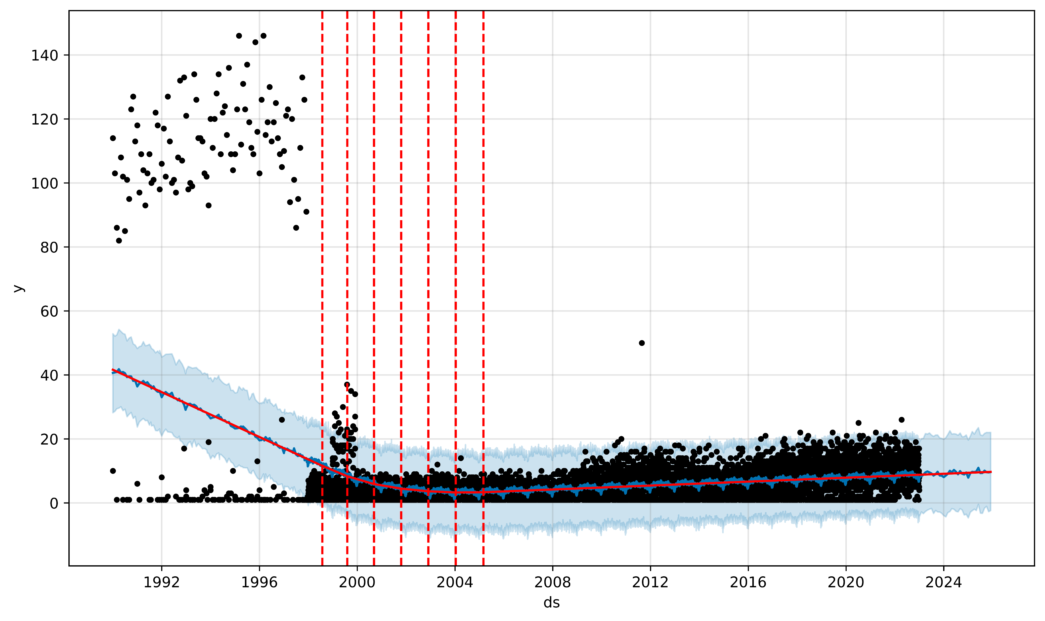
Restricting
Although there is less freedom for the trend line, there is still a clear growth for the following years.

Slide 30
Femicide Prediction (1990-2014)

Slide 31
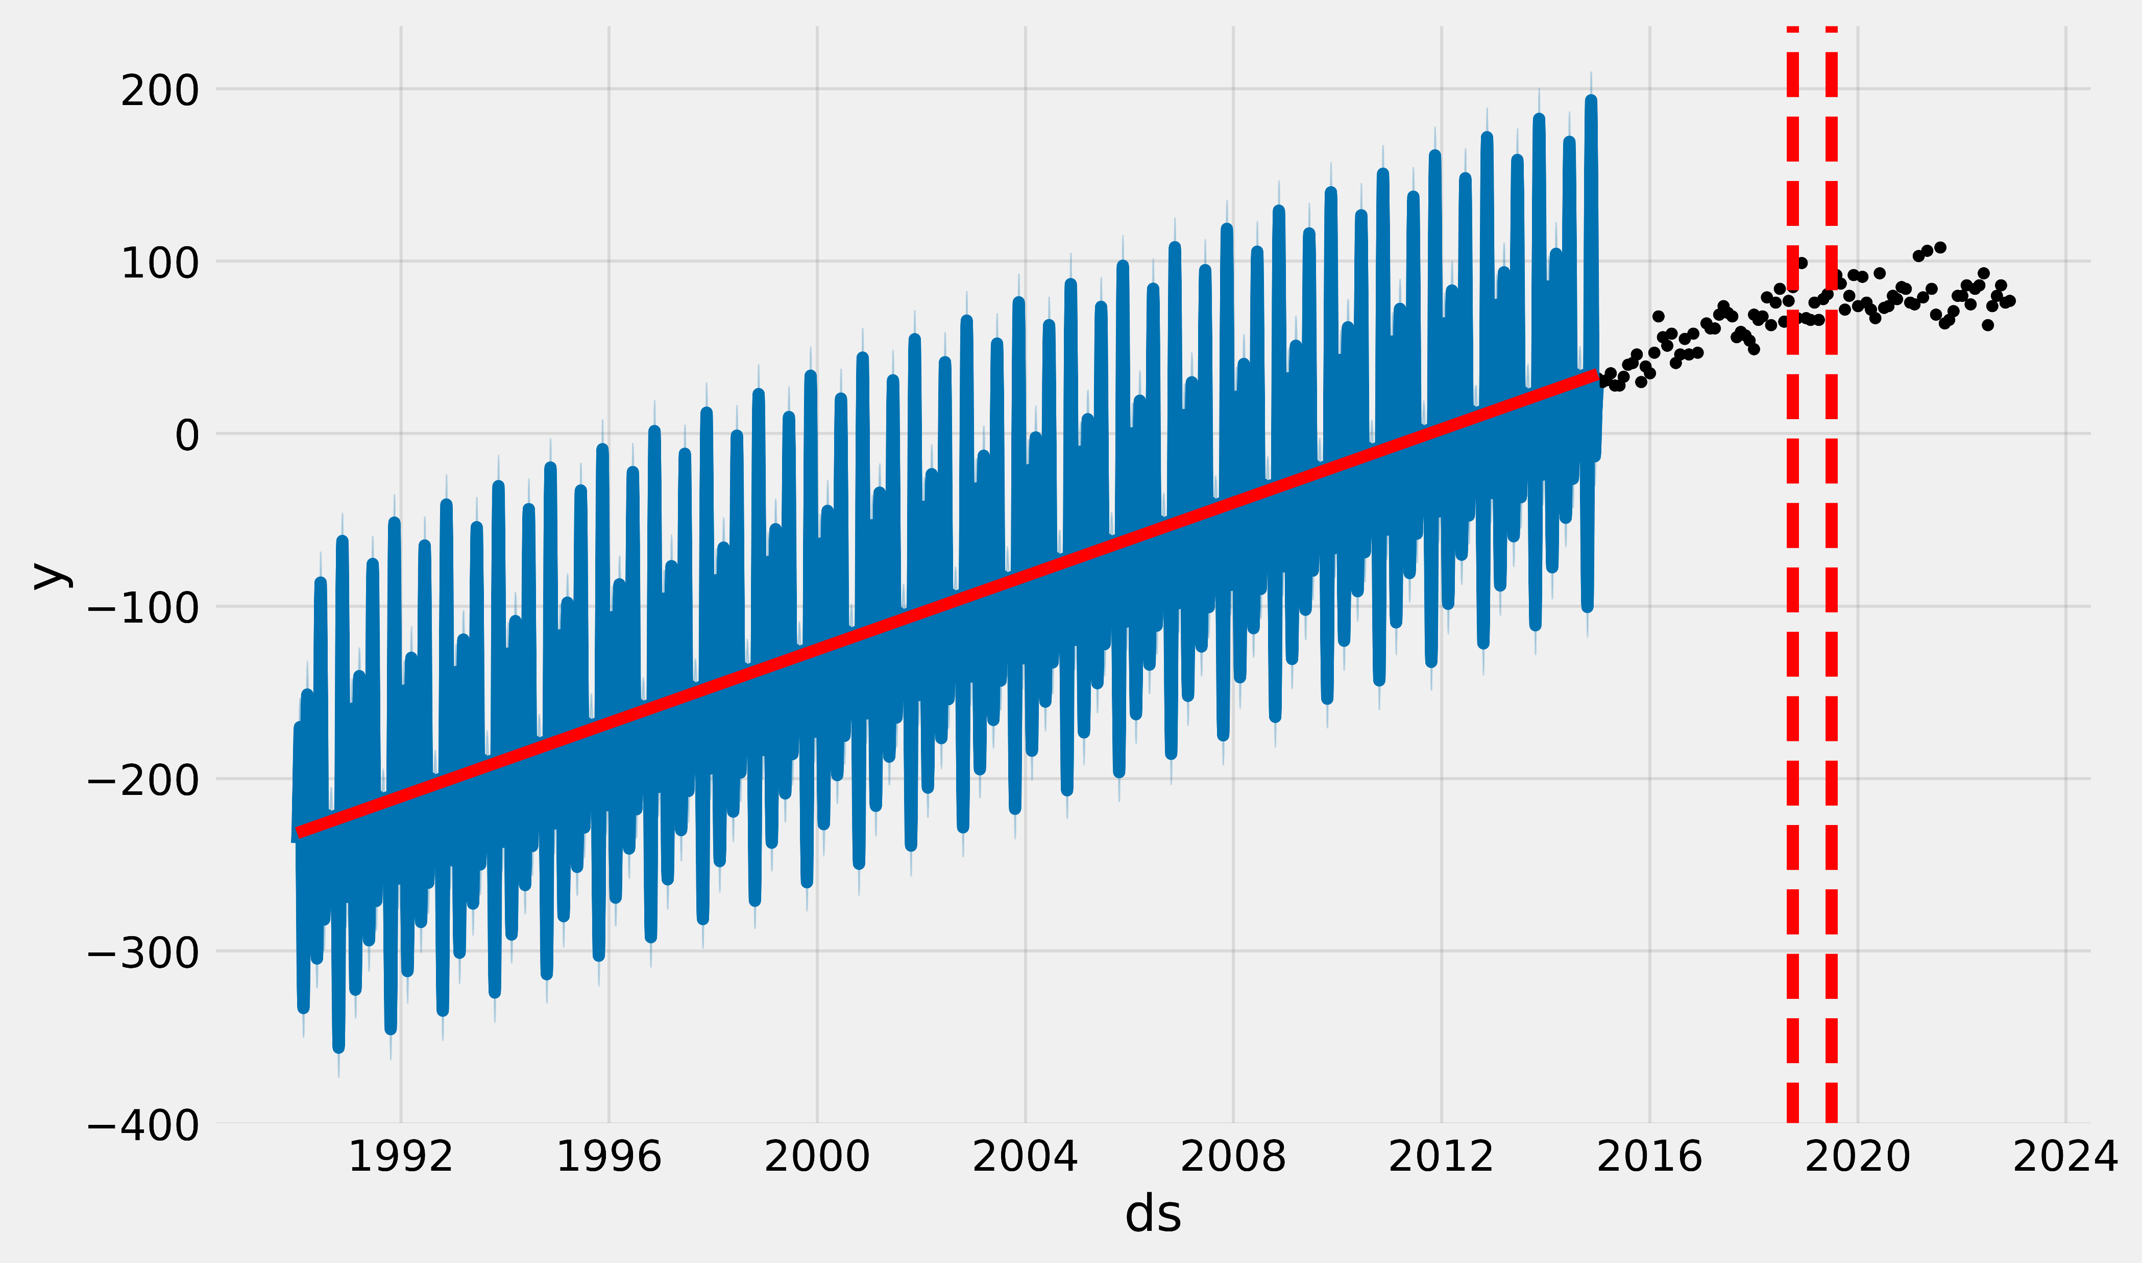
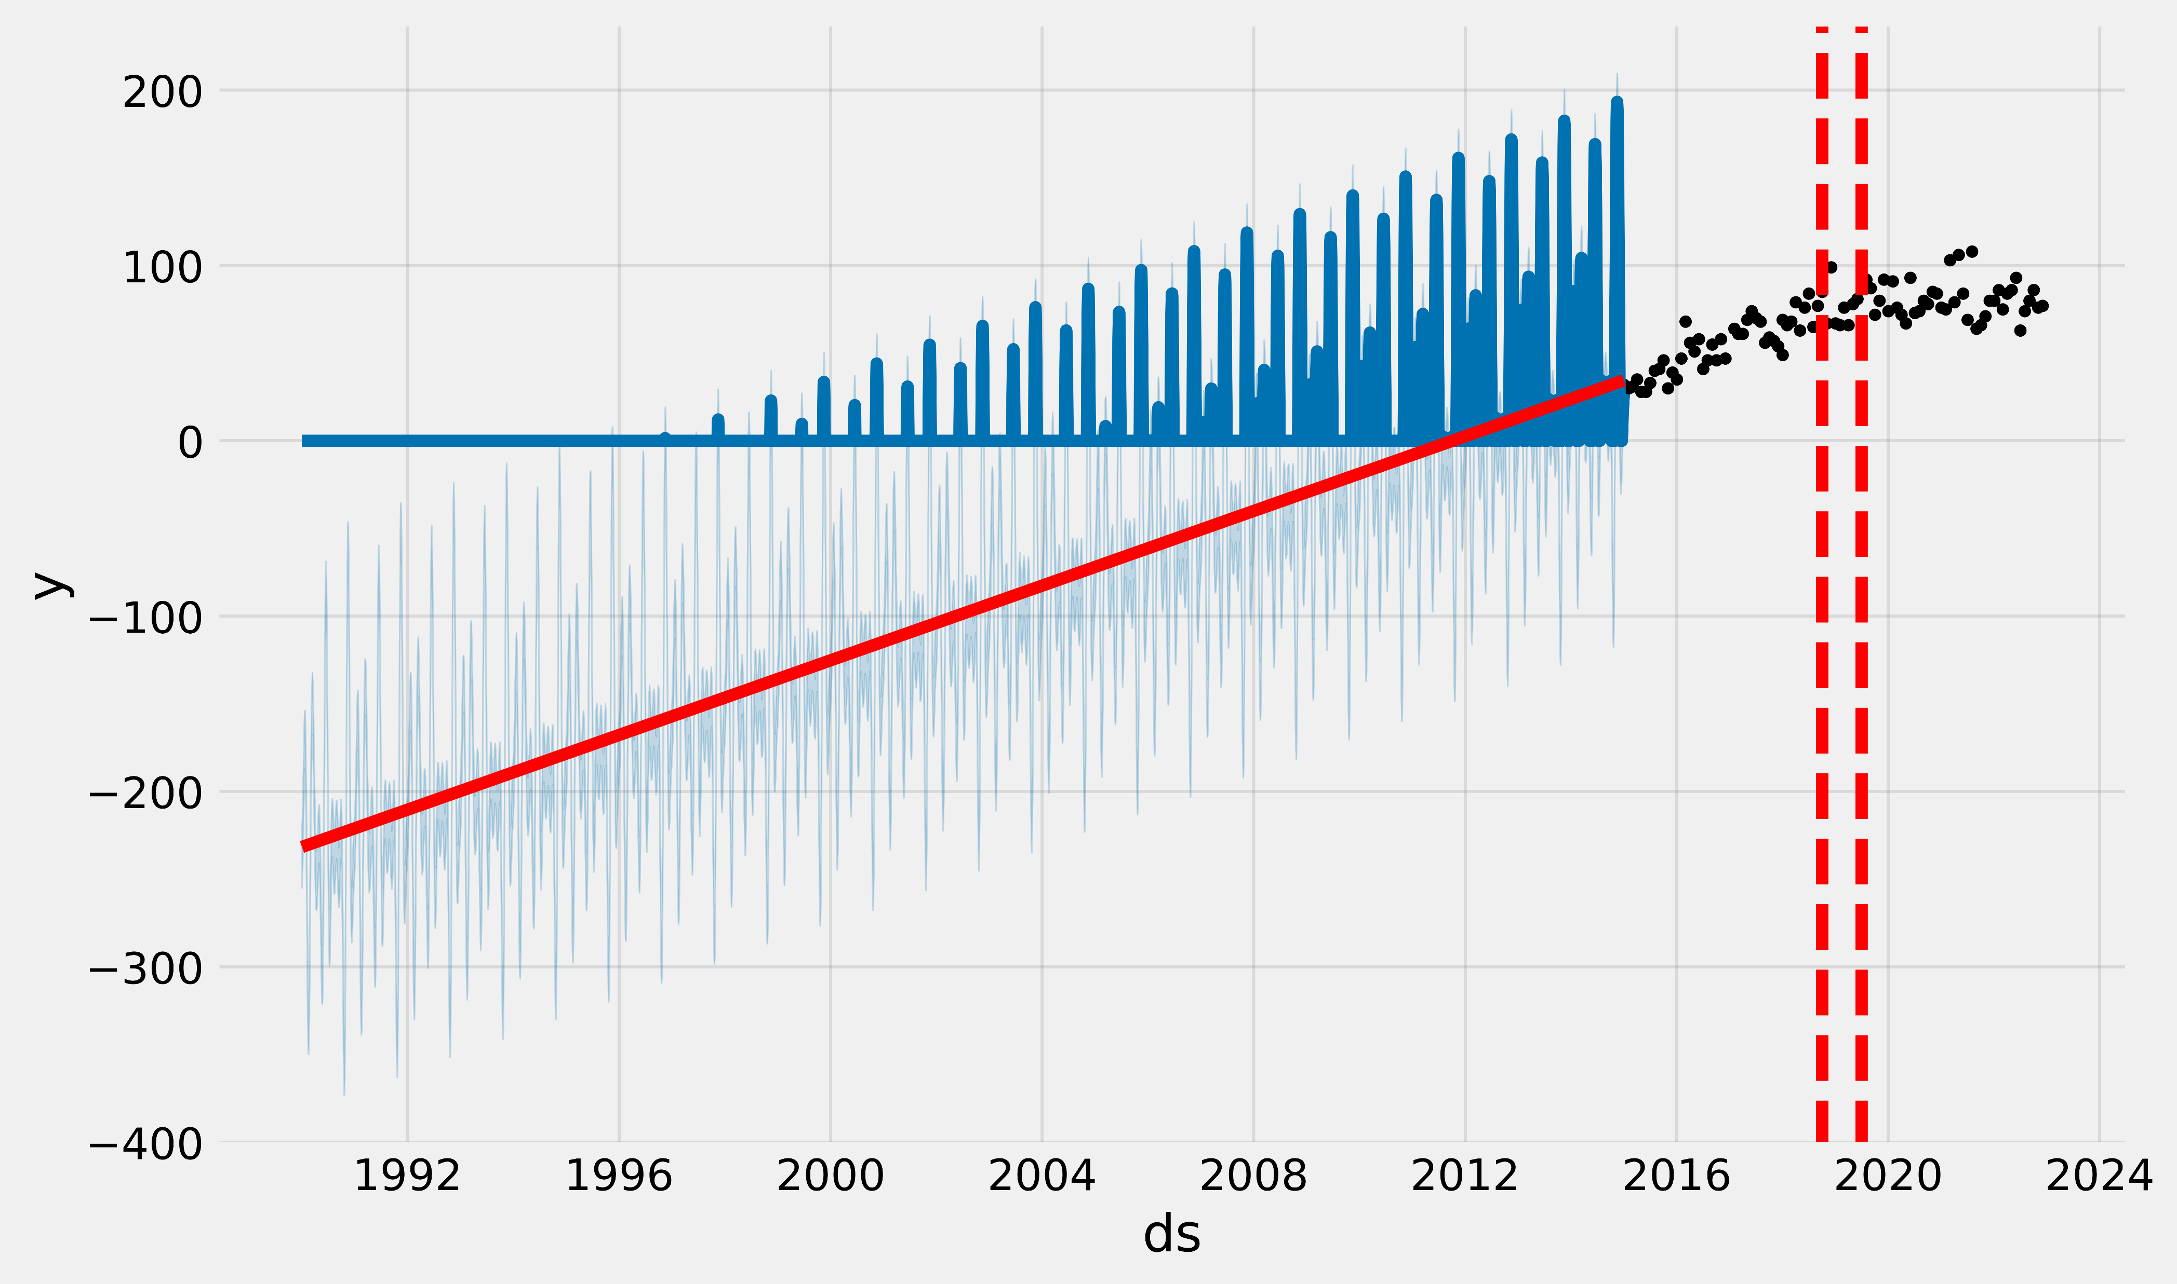
Problem The proposed model is not sufficient to be able to predict femicides per year for years that are not recorded.
Solution for the future Build a more powerful model that is capable of predicting femicides by considering the homicides of women.

Slide 32
Conclusions
The increase in femicides in Mexico is something that cannot be overlooked. This increase mainly seems to be thanks to a bad record on the part of the Mexican government. There is a need to have a better record of femicides and homicides of women in general. There is a need to increase the budget for research on violence against women. But above all, there must be more commitment on the part of the Mexican government to ensure that the law is enforced.

Slide 33
REMEMBER THAT THEY ARE NOT JUST NUMBERS, THEY WERE PEOPLE WITH LIVES THAT WERE TAKEN FROM THEM JUST BECAUSE THEY WERE WOMEN.

